Slide 1
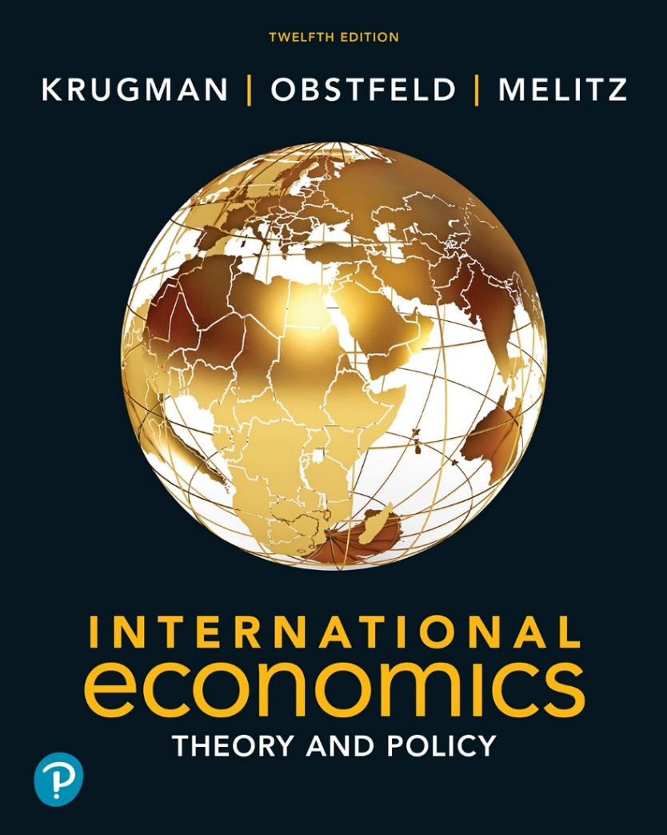

International Economics: Theory and Policy
Twelfth Edition
Chapter 10
The Political Economy of Trade Policy
Copyright © 2022, 2018, 2015 Pearson Education, Inc. All Rights Reserved
Notes:
If this PowerPoint presentation contains mathematical equations, you may need to check that your computer has the following installed:
1) MathType Plugin
2) Math Player (free versions available)
3) NVDA Reader (free versions available)

Slide 2
Learning Objectives
10.1 Articulate arguments for free trade that go beyond the conventional gains from trade.
10.2 Evaluate national welfare arguments against free trade.
10.3 Relate the theory and evidence behind “political economy” views of trade policy.
10.4 Explain how international negotiations and agreements have promoted world trade.
10.5 Discuss the special issues raised by preferential trade agreements.

Slide 3
Preview
The cases for free trade
The cases against free trade
Political models of trade policy
International negotiations of trade policy and the World Trade Organization

Slide 4
The Cases for Free Trade (1 of 6)
The first case for free trade is the argument that producers and consumers allocate resources most efficiently when governments do not distort market prices through trade policy.
National welfare of a small country is highest with free trade.
With restricted trade, consumers pay higher prices and consume too little while firms produce too much.

Slide 5
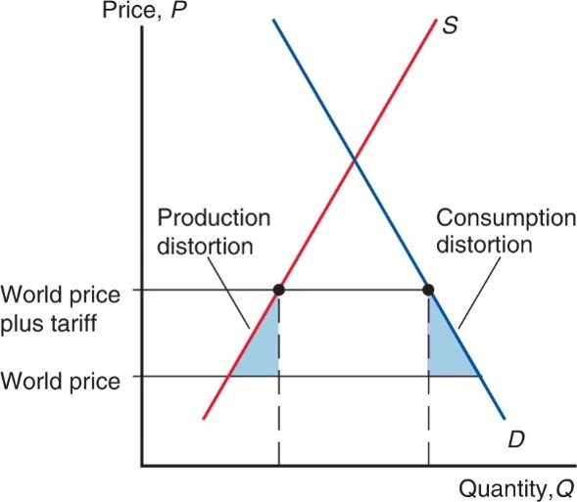
Figure 10.1 The Efficiency Case for Free Trade
A trade restriction, such as a tariff, leads to production and consumption distortions.
Notes:
Below their intersection on the y-axis are 2 lines, at y = world price and, above, y = world price plus tariff. Points are plotted on the S and D curves at y = world price plus tariff. A shaded triangle shape has the S curve as a left boundary, y = world price as the bottom boundary, and the point at y = world price plus tariff as the right boundary. This triangle represents production distortion. A second triangle has the D curve as the right boundary, y = world price as the bottom boundary, the point at y = world price plus tariff as the left boundary. This triangle represents consumption distortion.

Slide 6
The Cases for Free Trade (2 of 6)
However, because tariff rates are already low for most countries, the estimated benefits of moving to free trade are only a small fraction of national income for most countries.
For the world as a whole, protection costs less than 1 percent of G D P.
The gains from free trade are somewhat smaller for advanced economies such as the United States and Europe and somewhat larger for poorer developing countries.

Slide 7
Table 10.1 Benefits of a Move to Worldwide Free Trade (percent of G D P)
United States | 0.57
European Union | 0.61
Japan | 0.85
Developing countries | 1.4
World | 0.93
Source: William Cline, Trade Policy and Global Poverty (Washington, D.C.: Institute for International Economics, 2004), p.180.

Slide 8
The Cases for Free Trade (3 of 6)
Free trade allows firms or industry to take advantage of economies of scale.
Protected markets limit gains from external economies of scale by inhibiting the concentration of industries:
Too many firms to enter the protected industry.
The scale of production of each firm becomes inefficient.

Slide 9
The Cases for Free Trade (4 of 6)
Free trade provides competition and opportunities for innovation (dynamic benefits).
By providing entrepreneurs with an incentive to seek new ways to export or compete with imports, free trade offers more opportunities for learning and innovation.

Slide 10
The Cases for Free Trade (5 of 6)
Free trade avoids the loss of resources through rent seeking.
Spend time and other resources seeking quota rights and the profit that they will earn.

Slide 11
The Cases for Free Trade (6 of 6)
The political argument for free trade says that free trade is the best feasible political policy, even though there may be better policies in principle.
Any policy that deviates from free trade would be quickly manipulated by political groups, leading to decreased national welfare.

Slide 12
The Cases against Free Trade (1 of 8)
For a “large” country, a tariff lowers the price of imports in world markets and generates a terms of trade gain.
This benefit may exceed the losses caused by distortions in production and consumption.
A small tariff will lead to an increase in national welfare for a large country.
But at some tariff rate, the national welfare will begin to decrease as the economic efficiency loss exceeds the terms of trade gain.

Slide 13
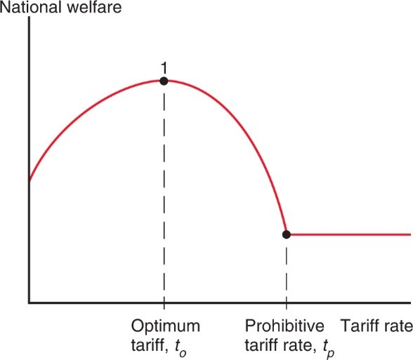
Figure 10.2 The Optimum Tariff
For a large country, there is an optimum tariff
at which the marginal
gain from improved terms of trade just equals the marginal efficiency loss from production and consumption distortion.
Notes:
An upside-down U-shaped curve extends from the y-axis, with point 1 at its peak, x = optimum tariff, t sub o. As the curve falls to the right with increasing steepness, the curve changes to a horizontal line at x = prohibitive tariff rate, t sub p.

Slide 14
The Cases against Free Trade (2 of 8)
A tariff rate that completely prohibits imports leaves a
country worse off, but tariff rate
may exist that
maximizes national welfare: an optimum tariff.
For some large countries like the United States, an import tariff and/or export tax could improve national welfare at the expense of other countries.
But this argument ignores the likelihood that other countries may retaliate against large countries by enacting their own trade restrictions.

Slide 15
The Cases against Free Trade (3 of 8)
An export tax (a negative export subsidy) that completely prohibits exports leaves a country worse off, but an export tax rate may exist that maximizes national welfare through the terms of trade.
An export subsidy lowers the terms of trade for a large country; an export tax raises the terms of trade for a large country.
An export tax may raise the price of exports in the world market, increasing the terms of trade.

Slide 16
The Cases against Free Trade (4 of 8)
A second argument against free trade is that domestic market failures may exist that cause free trade to be a suboptimal policy.
The economic efficiency loss calculations using consumer and producer surplus assume that markets function well.

Slide 17
The Cases against Free Trade (5 of 8)
Types of market failures include
Persistently high underemployment of workers
surpluses that are not eliminated in the market for labor because wages do not adjust
Persistently high underutilization of structures, equipment, and other forms of capital
surpluses that are not eliminated in the market for capital because prices do not adjust
Property rights not well defined or well enforced

Slide 18
The Cases against Free Trade (6 of 8)
Types of market failures include
technological benefits for society discovered through private production, but from which private firms cannot fully profit
environmental costs for society caused by private production, but for which private firms do not fully pay
sellers that are not well informed about the (opportunity) cost of production or buyers that are not well informed about value from consumption

Slide 19
The Cases against Free Trade (7 of 8)
Economists calculate the marginal social benefit to represent the additional benefit to society from private production.
With a market failure, marginal social benefit is not accurately measured by the producer surplus of private firms, so that economic efficiency loss calculations are misleading.
It’s possible that when a tariff increases domestic production, the benefit to domestic society will increase due to a market failure.

Slide 20
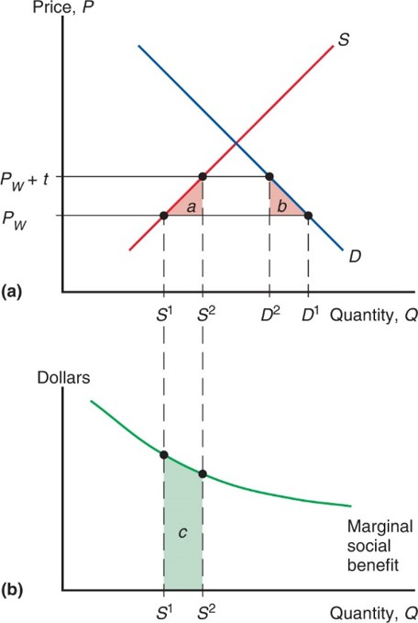
Figure 10.3 The Domestic Market Failure Argument for a Tariff
If production of a good yields extra social benefits [measured in panel (b) by area c] not captured as producer surplus, a tariff can increase welfare.
Notes:
Below the point of intersection is a horizontal line at y = P sub W + t, which crosses the S curve at (S super 2, P sub W + t) and the D curve at (D super 2, P sub W + t). These points form the top vertices for two separate shaded triangles that each have outer boundaries of the curves. The inner boundaries are the vertical lines at x = S super 2 and x = D super 2, respectively. The lower boundaries of the triangles are the horizontal line at y = P sub W. The shaded left triangle is ay and the shaded right triangle is b. Panel b shows a graph of dollars versus quantity, Q. A falling curve with decreasing steepness is the marginal social benefit. The area below the curve, between x = S super 1 and x = S super 2, with the x-axis as the lower boundary, is the shaded area c, which aligns with shaded area ay from the first graph.

Slide 21
The Cases against Free Trade (8 of 8)
The domestic market failure argument against free trade is an example of a more general argument called the theory of the second best.
Government intervention that distorts market incentives in one market may increase national welfare by offsetting the consequences of market failures elsewhere.
If the best policy, fixing the market failures, is not feasible, then government intervention in another market may be the “second-best” way of fixing the problem.

Slide 22
Counter-Arguments (1 of 2)
Economists supporting free trade counter-argue that domestic market failures should be corrected by a “first-best” policy: a domestic policy aimed directly at the source of the problem.
If persistently high underemployment of labor is a problem, then the cost of labor or production of labor-intensive products could be subsidized by the government.
This policy could avoid economic efficiency losses due to a tariff.

Slide 23
Counter-Arguments (2 of 2)
Unclear when and to what degree a market failure exists in the real world.
Government policies to address market failures are likely to be manipulated by politically powerful groups.
Due to distorting the incentives of producers and consumers, trade policy may have unintended consequences that make a situation worse, not better.

Slide 24
Political Models of Trade Policy
How is trade policy determined?
Models of governments maximizing political success rather than national welfare:
Median voter theorem
Collective action
A model that combines aspects of collective action and the median voter theorem

Slide 25
Median Voter (1 of 3)
The median voter theorem predicts that democratic political parties pick their policies to court the voter in the middle of the ideological spectrum (i.e., the median voter).
Suppose the level of a tariff rate is the policy issue.
Line up all the voters according to the tariff rate they prefer, starting with those who favor the lowest rate.

Slide 26
Median Voter (2 of 3)
Assumptions of the model:
There are two competing political parties.
The objective of each party is to get elected by majority vote.
What policies will the parties promise to follow?
Both parties will offer the same tariff policy to court the median voter (the voter in the middle of the spectrum) in order to capture the most votes.

Slide 27
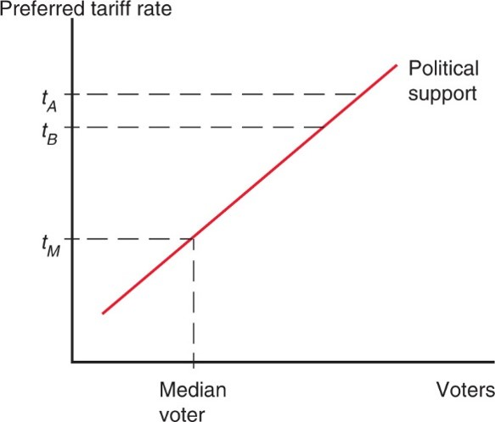
Figure 10.4 Political Competition
Voters are lined up in order of the tariff rate they prefer. If one party proposes
a high tariff of
the other party can win over most of the voters by offering
a Somewhat lower tariff,
This Political Competition drives both parties
to propose tariffs close to
the tariff preferred by the median voter.
Notes:
3 dashed lines are drawn from the y-axis to the line. Y = t sub M intersects the line at x = median voter. Y = t sub B intersects the line at a higher point, and y = t sub Ay at the highest point.

Slide 28
Median Voter (3 of 3)
Thus, the median voter theorem implies that a two-party democracy should enact trade policy based on how many voters it pleases.
A policy that inflicts large losses on a few people (import-competing producers) but benefits a large number of people (consumers) should be chosen.
But trade policy doesn't follow this prediction.

Slide 29
Collective Action (1 of 2)
Political activity is often described as a collective action problem:
While consumers as a group have an incentive to advocate free trade, each individual consumer has no incentive because his benefit is not large compared to the cost and time required to advocate free trade.
Policies that impose large losses for society as a whole but small losses on each individual may therefore not face strong opposition.

Slide 30
Collective Action (2 of 2)
However, for groups who suffer large losses from free trade (e.g., unemployment), each individual in that group has a strong incentive to advocate the policy he desires.
In this case, the cost and time required to advocate restricted trade is small compared to the cost of unemployment.

Slide 31
A Model of Trade Policy
While politicians may win elections partly because they advocate popular policies as implied by the median voter theorem, they also require funds to run campaigns.
These funds may especially come from groups who do not have a collective action problem and are willing to advocate a special interest policy.
Models of trade restrictions try to measure the trade-off between the reduction in welfare of constituents as a whole and the increase in campaign contributions from special interests.

Slide 32
Which Industries Are Protected? (1 of 2)
Agriculture: In the United States, Europe, and Japan, farmers make up a small fraction of the electorate but receive generous subsidies and trade protection.
Examples: European Union’s Common Agricultural Policy, Japan’s 1000% tariff on imported rice, America’s sugar quota.

Slide 33
Which Industries Are Protected? (2 of 2)
Clothing: textiles (fabrication of cloth) and apparel (assembly of cloth into clothing).
Until 2005, quota licenses granted to textile and apparel exporters were specified in the Multi-Fiber Agreement between the United States and many other nations.
Phase-out of M F A drastically reduced the costs of U.S. protection, from 14.1b in 2002 (11.8b from textiles and apparel) to 2.6b estimate for 2015 (only 0.5b from textiles and apparel).

Slide 34
Table 10.2 Welfare Costs of U.S. Protection ($ billion)
blank | 2002 Estimate | 2015 Projected?
Total | 14.1 | 2.6
Textiles and apparel | 11.8 | 0.5
Source: U.S. International Trade Commission.

Slide 35
International Negotiations of Trade Policy (1 of 4)
After rising sharply at the beginning of the 1930s, the average U.S. tariff rate has decreased substantially from the mid-1930s to 1998.
Since 1944, much of the reduction in tariffs and other trade restrictions has come about through international negotiations.
The General Agreement of Tariffs and Trade was begun in 1947 as a provisional international agreement and was replaced by a more formal international institution called the World Trade Organization in 1995.

Slide 36
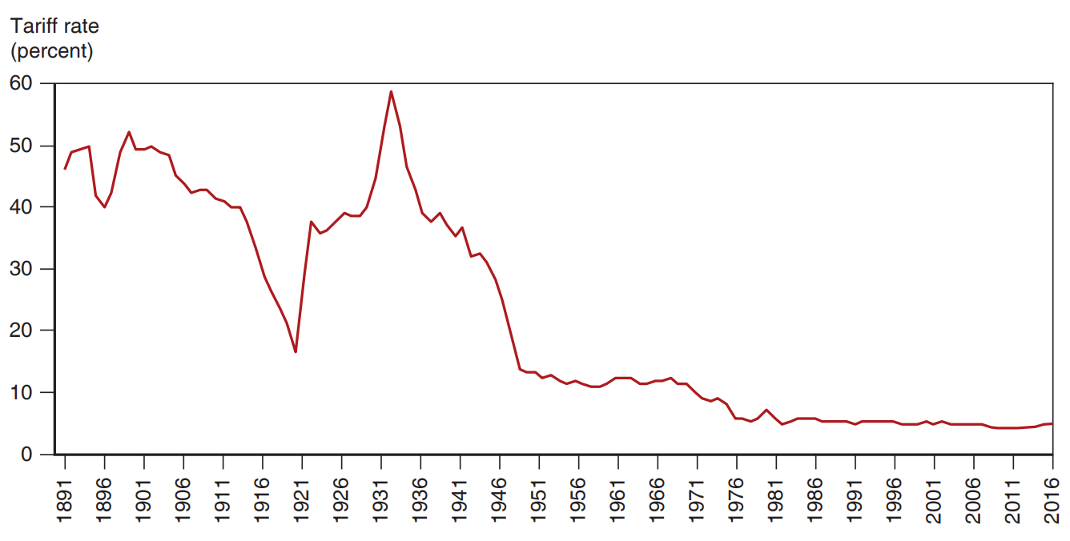
Figure 10.5 The U.S. Tariff Rate
After rising sharply at the beginning of the 1930s, the average tariff rate of the United States has steadily declined until the eve of the U.S.-China trade war.
Notes:
The tariff rate in percent for the U S is plotted versus year, 18 91 to 20 16. From 18 91 to 19 12, the tariff rate gradually declines from 48% to 40%. In 19 21, a large dip to 15% occurs and then in 19 32 the tariff rate rises to a peak of 59%. Until 19 48, the rate drops rapidly to 12%. From 19 48 to 20 16, the rate declines gradually, with a tariff rate of 4% in 20 16. All values are estimated.

Slide 37
International Negotiations of Trade Policy (2 of 4)
Multilateral negotiations mobilize exporters to support free trade if they believe export markets will expand.
This support would be lacking in a unilateral push for free trade. The multilateral approach counteracts the support for restricted trade by import-competing groups.

Slide 38
International Negotiations of Trade Policy (3 of 4)
Multilateral negotiations also help avoid a trade war between countries, where each country enacts trade restrictions.
A trade war could result if each country has an incentive to adopt protection, regardless of what other countries do.
All countries could enact trade restrictions, even if it is in the interest of all countries to have free trade.
Countries need an agreement that prevents a trade war or eliminates the protection from one.

Slide 39
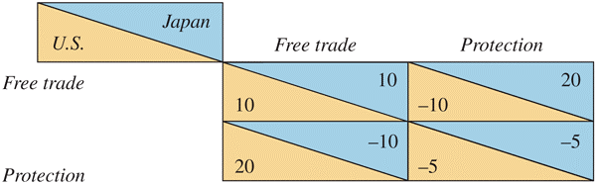
Table 10.3 The Problem of Trade Warfare
Notes:
Free trade on both sides: U S, 10; Japan, 10. Free trade from one side, protection by the other: U S, negative 10; Japan, 20. Protection from one side, free trade by the other: U S, 20; Japan, negative 10. Protection on both sides: U S, negative 5; Japan, negative 5.

Slide 40
International Negotiations of Trade Policy (4 of 4)
In this example, each country acting individually would
be better off with protection
but both would be
better off if both chose free trade than if both choose
protection
If Japan and the United States can establish a binding agreement to maintain free trade, both can avoid the temptation of protection and both can be made better off.
Or if the damage has already been done, both countries can agree to return to free trade.

Slide 41
International Trade Agreements: A Brief History
In 1930, the United States passed a remarkably irresponsible tariff law, the Smoot-Hawley Act.
Tariff rates rose steeply and U.S. trade fell sharply.
Initial attempts to reduce tariff rates were undertaken through bilateral trade negotiations:
The United States offered to lower tariffs on some imports if another country would lower its tariffs on some U.S. exports.
Bilateral negotiations, however, do not take full advantage of international coordination.
Benefits can “spill over” to countries that have not made any concessions.

Slide 42
World Trade Organization (1 of 7)
In 1947, a group of 23 countries began trade negotiations under a provisional set of rules that became known as the General Agreement on Tariffs and Trade, or G A T T.
In 1995, the World Trade Organization, or W T O, was established as a formal organization for implementing multilateral trade negotiations (and policing them).

Slide 43
World Trade Organization (2 of 7)
W T O negotiations address trade restrictions in at least three ways:
Reducing tariff rates through multilateral negotiations.
Binding tariff rates: a tariff is “bound” by having the imposing country agree not to raise it in the future.

Slide 44
World Trade Organization (3 of 7)
Eliminating nontariff barriers: quotas and export subsidies are changed to tariffs because the costs of tariff protection are more apparent and easier to negotiate.
Subsidies for agricultural exports are an exception.
Exceptions are also allowed for “market disruptions” caused by a surge in imports.

Slide 45
World Trade Organization (4 of 7)
The World Trade Organization is based on a number of agreements:
General Agreement on Tariffs and Trade: covers trade in goods.
General Agreement on Tariffs and Services: covers trade in services (e.g., insurance, consulting, legal services, banking).
Agreement on Trade-Related Aspects of Intellectual Property: covers international property rights (e.g., patents and copyrights).

Slide 46
World Trade Organization (5 of 7)
The dispute settlement procedure: a formal procedure where countries in a trade dispute can bring their case to a panel of W T O experts to rule upon.
The panel decides whether member counties are breaking their agreements.
A country that refuses to adhere to the panel’s decision may be punished by the W T O allowing other countries to impose trade restrictions on its exports.

Slide 47
World Trade Organization (6 of 7)
The G A T T multilateral negotiations in the Uruguay Round, ratified in 1994:
agreed that all quantitative restrictions (e.g., quotas) on trade in textiles and clothing as previously specified in the Multi-Fiber Agreement were to be eliminated by 2005.
Quotas on imports from China had to be temporarily reimposed due to surge in Chinese clothing exports when M F A expired.

Slide 48
World Trade Organization (7 of 7)
In 2001, a new round of negotiations was started in Doha, Qatar, but these negotiations never produced an agreement.
Most of the remaining forms of protection are in agriculture, textiles, and clothing—industries that are politically well organized.

Slide 49
Table 10.4 Percentage Distribution of Potential Gains from Free Trade
Economy | Full Liberalization of Agriculture and Food | Full Liberalization of Textiles and Clothing | Full Liberalization of Other Merchandise | Full Liberalization of All Goods
Developed | 46 | 6 | 3 | 55
Developing | 17 | 8 | 20 | 45
All | 63 | 14 | 23 | 100
Source: Kym Anderson and Will Martin, “Agricultural Trade Reform and the Doha Agenda,” The World Economy 28 (September 2005), p p. 1301–1327.

Slide 50
Do Agricultural Subsidies in Rich Countries Hurt Poor Countries?
We learned in Chapter 9 that subsidies lower the world price of products.
Since importing countries benefit from cheaper food, why would poor countries want rich countries to remove their agricultural subsidies?
Subsidies harm farmers in poor countries who compete with farmers in rich countries.

Slide 51
Table 10.5 Percentage Gains in Income under Two Doha Scenarios
blank | Ambitious | Less Ambitious
High-income | 0.20 | 0.05
Middle-income | 0.10 | 0.00
China | negative 0.02 | negative 0.05
Low-income | 0.05 | 0.01
World | 0.18 | 0.04

Slide 52
Preferential Trading Agreements (1 of 5)
Preferential trading agreements are trade agreements between countries in which they lower tariffs for each other but not for the rest of the world.
Under the W T O, such discriminatory trade policies are generally not allowed:
Each country in the W T O promises that all countries will pay tariffs no higher than the nation that pays the lowest: called the “most favored nation” (M F N) principle.
An exception is allowed only if the lowest tariff rate is set at zero.

Slide 53
Preferential Trading Agreements (2 of 5)
There are two types of preferential trading agreements in which tariff rates are set at or near zero:
A free trade area: an agreement that allows free trade among members, but each member can have its own trade policy towards non-member countries.
An example is the North America Free Trade Agreement (N A F T A), now the U.S.-Mexico-Canada Agreement (U S M C A).

Slide 54
Preferential Trading Agreements (3 of 5)
A customs union: an agreement that allows free trade among members and requires a common external trade policy towards non-member countries.
An example is the European Union.

Slide 55
Preferential Trading Agreements (4 of 5)
Are preferential trading agreements necessarily good for national welfare?
No, it is possible that national welfare decreases under a preferential trading agreement.
How? Rather than gaining tariff revenue from inexpensive imports from world markets, a country may import expensive products from member countries but not gain any tariff revenue.

Slide 56
Preferential Trading Agreements (5 of 5)
Preferential trading agreements increase national welfare when new trade is created, but not when existing trade from the outside world is diverted to trade with member countries.
Trade creation
occurs when high-cost domestic production is replaced by low-cost imports from other members.
Trade diversion
occurs when low-cost imports from non-members are diverted to high-cost imports from member nations.

Slide 57
Brexit
In 2016, the European Union experienced a shock when Britain voted by a narrow majority to leave.
Why exit? The decision was likely more about objections to standardized regulations and free movement of people among member countries than it was about free trade.
New members from former Communist countries in Eastern Europe, such as Romania and Bulgaria, created a rising flow of immigrants to richer European nations.
Concern that immigrants take jobs and overburden public services (ignoring potential benefits).
Also fears that national identity is being undermined.

Slide 58
Trans Pacific Partnership (T P P)
Negotiators from twelve countries around the Pacific Rim, including the united States but not China, agreed on a proposal for a new economic agreement called the trans Pacific Partnership (T P P) in 2016.
T P P not approved due to backlash against globalization.
Conventional barriers to trade such as import quotas and tariffs were already largely eliminated so not much room for improvement there.
Tried to strengthen intellectual property rights to better enforce patents and copyrights across borders, and to advance dispute settlement between private business and national governments.

Slide 59
Summary (1 of 3)
The cases for free trade are that freer trade
allows consumers and producers to allocate their resources freely and efficiently, without price distortions.
may allow for economies of scale.
increases competition and innovation.
The cases against free trade are that trade restrictions may allow
terms of trade gains.
a government to address a market failure when better policies are not feasible.

Slide 60
Summary (2 of 3)
Models of trade policy choice consider the incentives politicians face given their desire to be reelected, and the tendency for groups that gain from protection to be better organized than consumers who lose.
Agricultural and clothing industries are the most protected industries in many countries.

Slide 61
Summary (3 of 3)
Multilateral negotiations of free trade may mobilize domestic political support for free trade, as well as make countries agree not to engage in a trade war.
The W T O and its predecessor have reduced tariffs substantially in the last 50 years, and the W T O has a dispute settlement procedure for trade disputes.
A preferential trading agreement is beneficial for a country if it creates new trade but is harmful if it diverts existing trade to higher-cost alternatives.

Slide 62
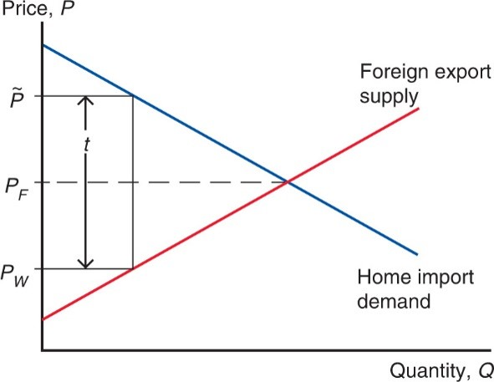
Figure 10A.1 Effects of a Tariff on Prices
In a linear model, we can calculate the exact effect of a tariff on prices.
Notes:
Both lines start at the y-axis., and intersect at y = P sub F. Y = P sub F is roughly midway y = P sub W, which intersects the foreign export supply line below; and y = P tilde, which intersects the home import demand line above. The distance between the upper and lower horizontal lines represents, t.

Slide 63
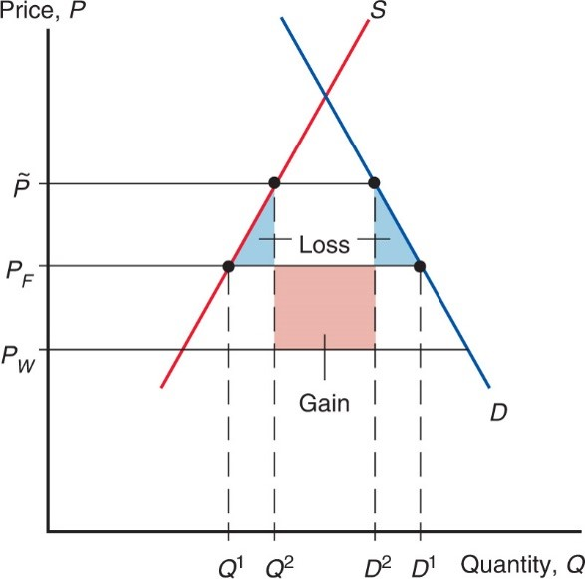
Figure 10A.2 Welfare Effects of a Tariff
The net benefit of a tariff is equal to the area of the colored rectangle minus the area of the two shaded triangles.
Notes:
The S curve rises through y = P sub W, then through (Q super 1, P sub F) and (Q super 2, P tilde). The D curve falls through (D super 2, P tilde) and then (D super 1, P sub F). Between y = P tilde above and y = P sub F below, shaded triangular areas below the S and D curves, and between x = Q super 1 and x = Q super 1, for the S curve, and x = D super 2 and x = D super 1, for the D curve, represent loss. A shaded square area between y = P sub F above, y = P sub W below, x = Q super 2 at the left, and x = D super 2 at the right, represents gain.

Slide 64

Copyright
This work is protected by United States copyright laws and is provided solely for the use of instructors in teaching their courses and assessing student learning. Dissemination or sale of any part of this work (including on the World Wide Web) will destroy the integrity of the work and is not permitted. The work and materials from it should never be made available to students except by instructors using the accompanying text in their classes. All recipients of this work are expected to abide by these restrictions and to honor the intended pedagogical purposes and the needs of other instructors who rely on these materials.

